Slide 1

Password Cracking
by sofia filippatou

Slide 2
Why do we still use passwords today ?

Slide 3
Basic Concept: Most people understand the basic concept of a password
Widespread Use: Passwords are used across a vast array of platforms and services
Accessibility: Passwords do not require specialized equipment or technology, making them accessible to a wide range of users

Slide 4
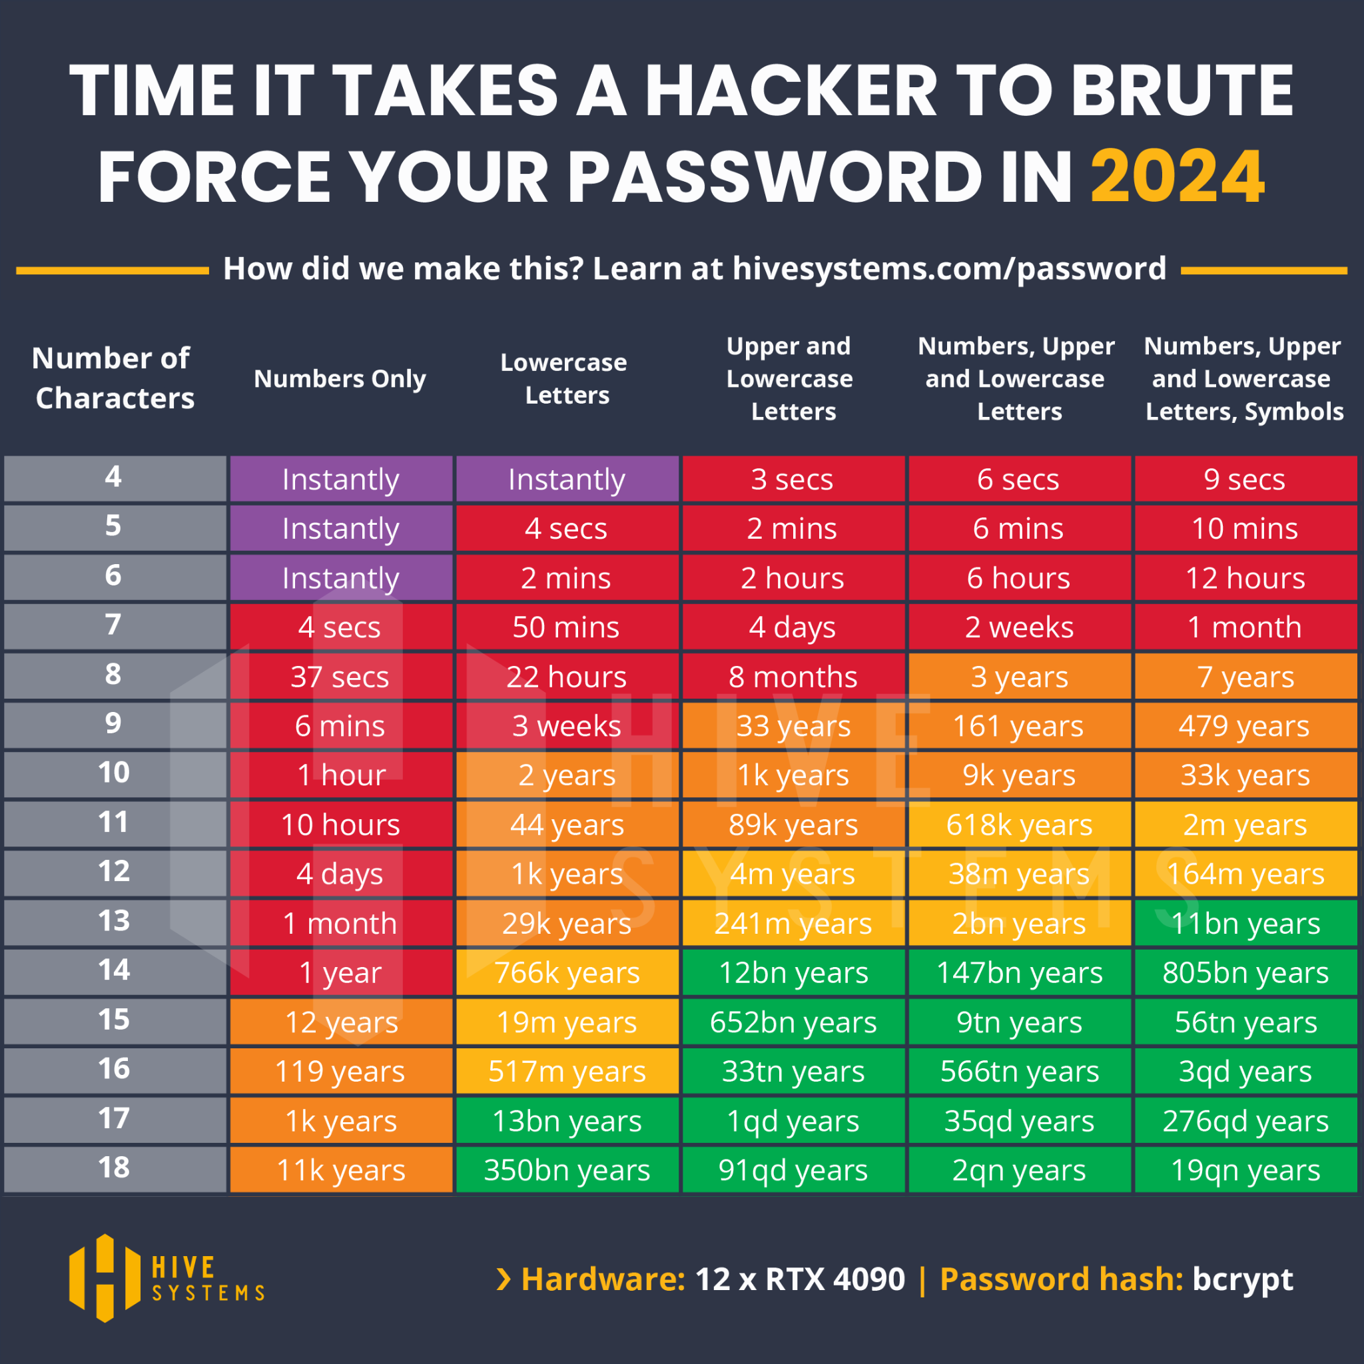

Slide 5
Example

Slide 6
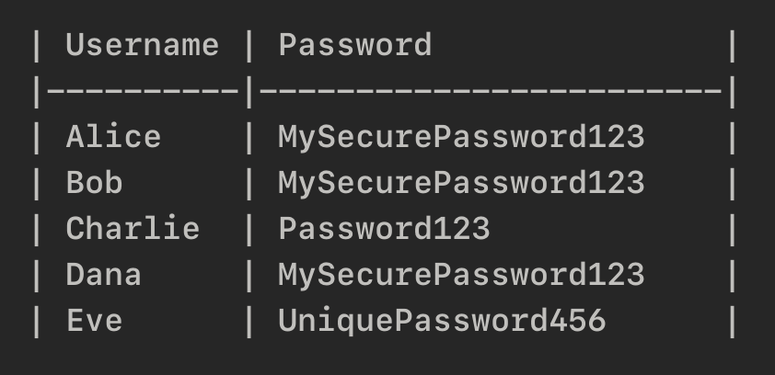

Slide 7
What do you find wrong with this way of storing passwords ?

Slide 8

(Cryptographic) Hash Functions

Slide 9
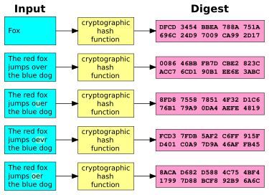

Slide 10
What are the properties of hash functions ?

Slide 11
NO collisions: Computationally infeasible to find two different inputs that produce the same hash output
One-way: NOT reversible, NO decrypt
Deterministic: Same input <-> Same output
Uniform distribution: The outputs are random, unpredictable

Slide 12
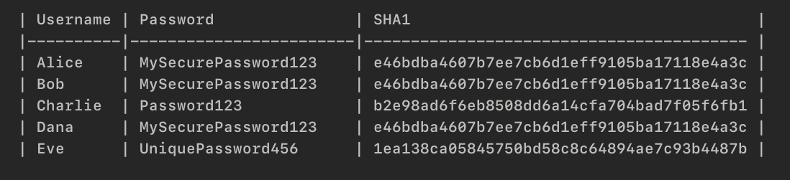

Slide 13
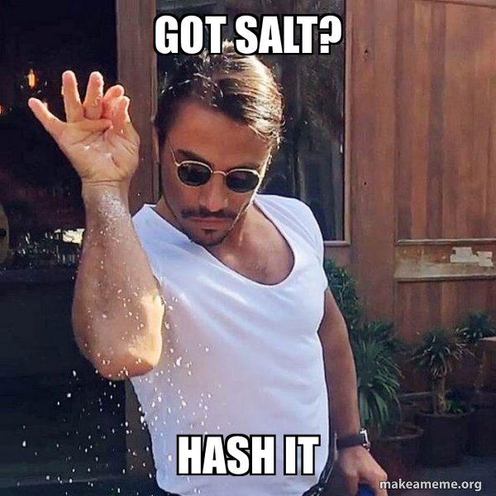
What is salting ?

Slide 14
What is salting ?
Salting is essentially the addition of random data before it is put through a hash function, and they are most commonly used with passwords.

Slide 15
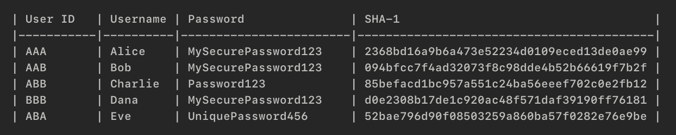
After Salting

Slide 16


Slide 17
sudo cat /etc/shadow
It is a file on Unix and Linux systems that stores user account information, including hashed passwords.
Source: https://linuxize.com/post/etc-shadow-file/

Slide 18
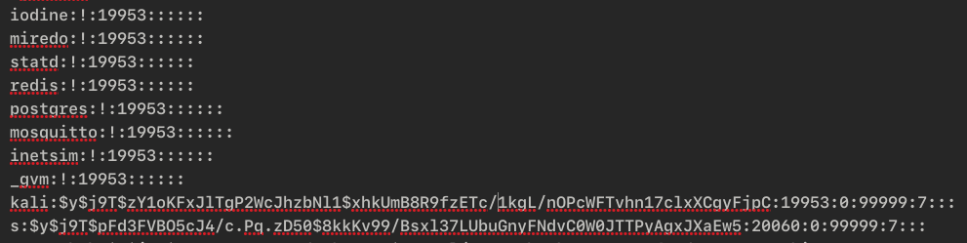
$id$salt$encrypted
Hash-identifier: https://hashes.com/en/tools/hash_identifier

Slide 19
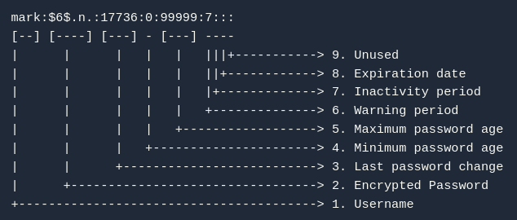

Source: https://www.baeldung.com/linux/shadow-passwords

Slide 20

Password cracking using

Slide 21
Example
Open terminal
Download:
(Do sudo apt-get install john)
Do unshadow passwd-copy.txt shadow-copy.txt > crack.txt
Remove everything from the file except for the users
Do john crack.txt
What do you see ?

Slide 22
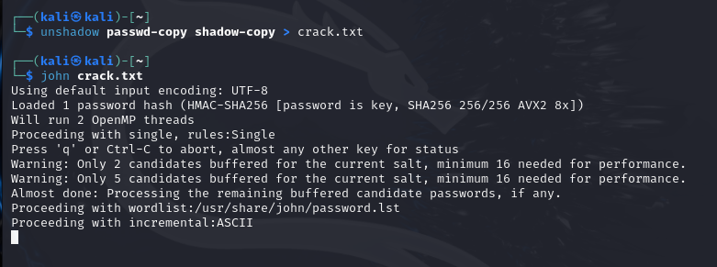

Slide 23
More things to crack..
Windows Password Hashes
PDF Files
ZIP and RAR Archives

Slide 24
Wordlists

Slide 25
Wordlists
A wordlist is a text file that contains a list of words or phrases, typically one per line. These words can be anything from common passwords, dictionary words, usernames, or even phrases that people might use in their passwords.

Slide 26

Password cracking using

Slide 27
hashcat -m 0 -a 0 hash.txt wordlist.txt
hashcat: Main command to run the program (on Windows, use hashcat.exe)
-m 0: Hash type (In this case, 0 represents MD5)
-a 0: Attack mode (In this case, 0 stands for "straight" mode, a dictionary attack)
hash.txt: This file contains the hash of hashes you're trying to crack
wordlist.txt: This is your dictionary or list of potential passwords
Source: https://www.stationx.net/how-to-use-hashcat/

Slide 28
Final Thoughts

Slide 29
Final Thoughts
Password cracking is a critical aspect of cybersecurity that involves the process of recovering passwords from data that has been stored in a hashed or encrypted format.
However, every password can be cracked given sufficient time and computational power.

Slide 30
Today we’ll use
https://tryhackme.com/r/room/crackthehash
https://tryhackme.com/r/room/crackthehashlevel2

Slide 31


